Slide 1
NEW YORK CITY BIKE

Slide 2
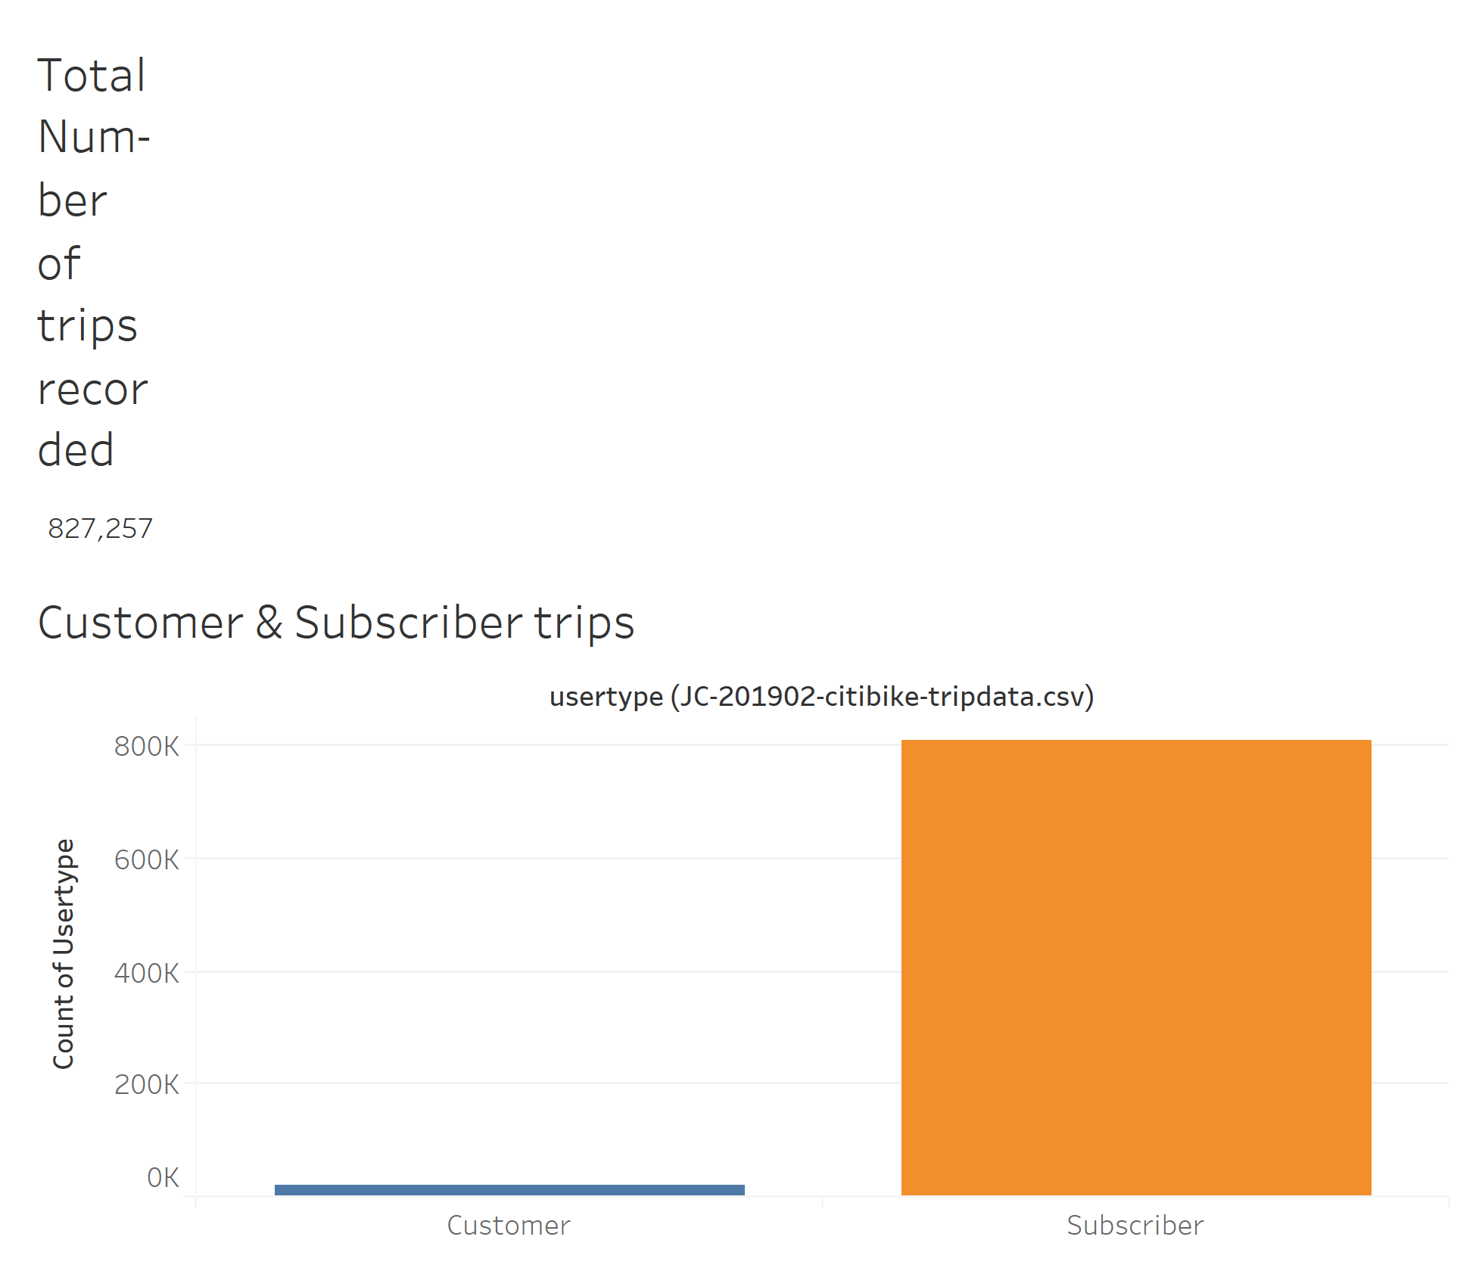
Over 800,000 trips were taken in January and February.
Subscribers took more trips than one time customers.

Slide 3
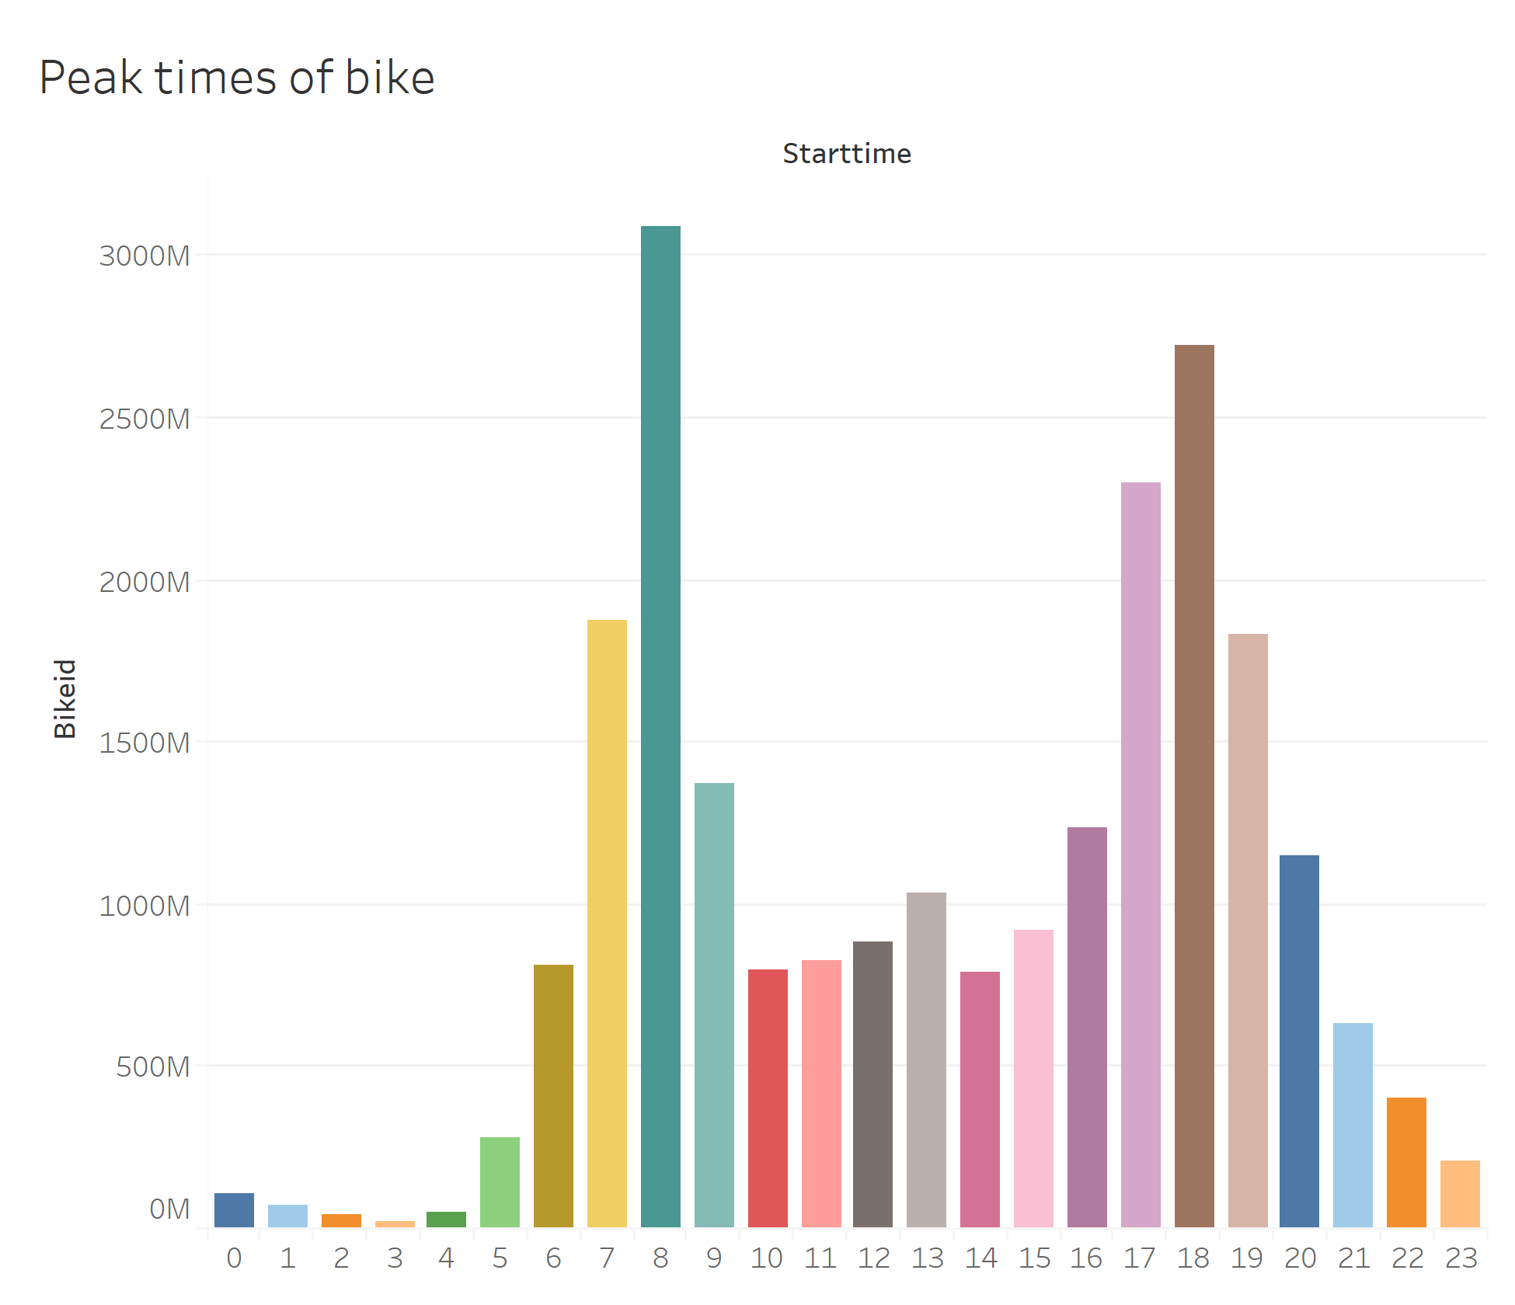
The peak time for bikers is 8am and 6pm.
These are rush hour times.

Slide 4
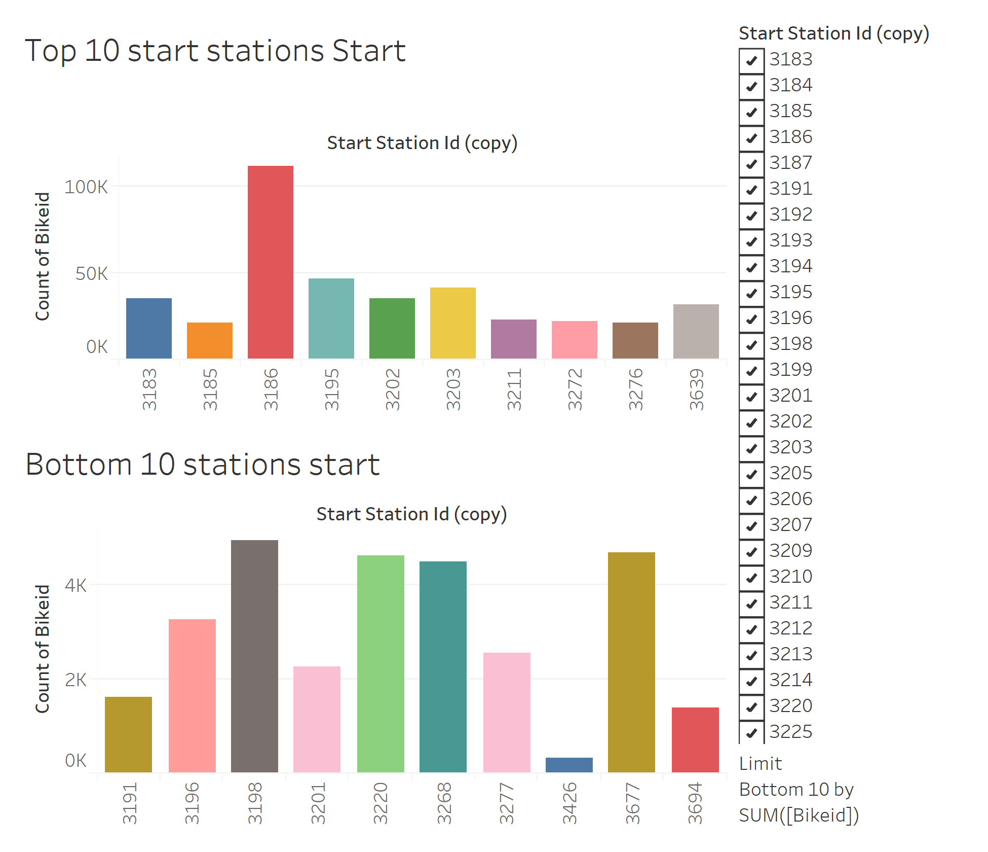
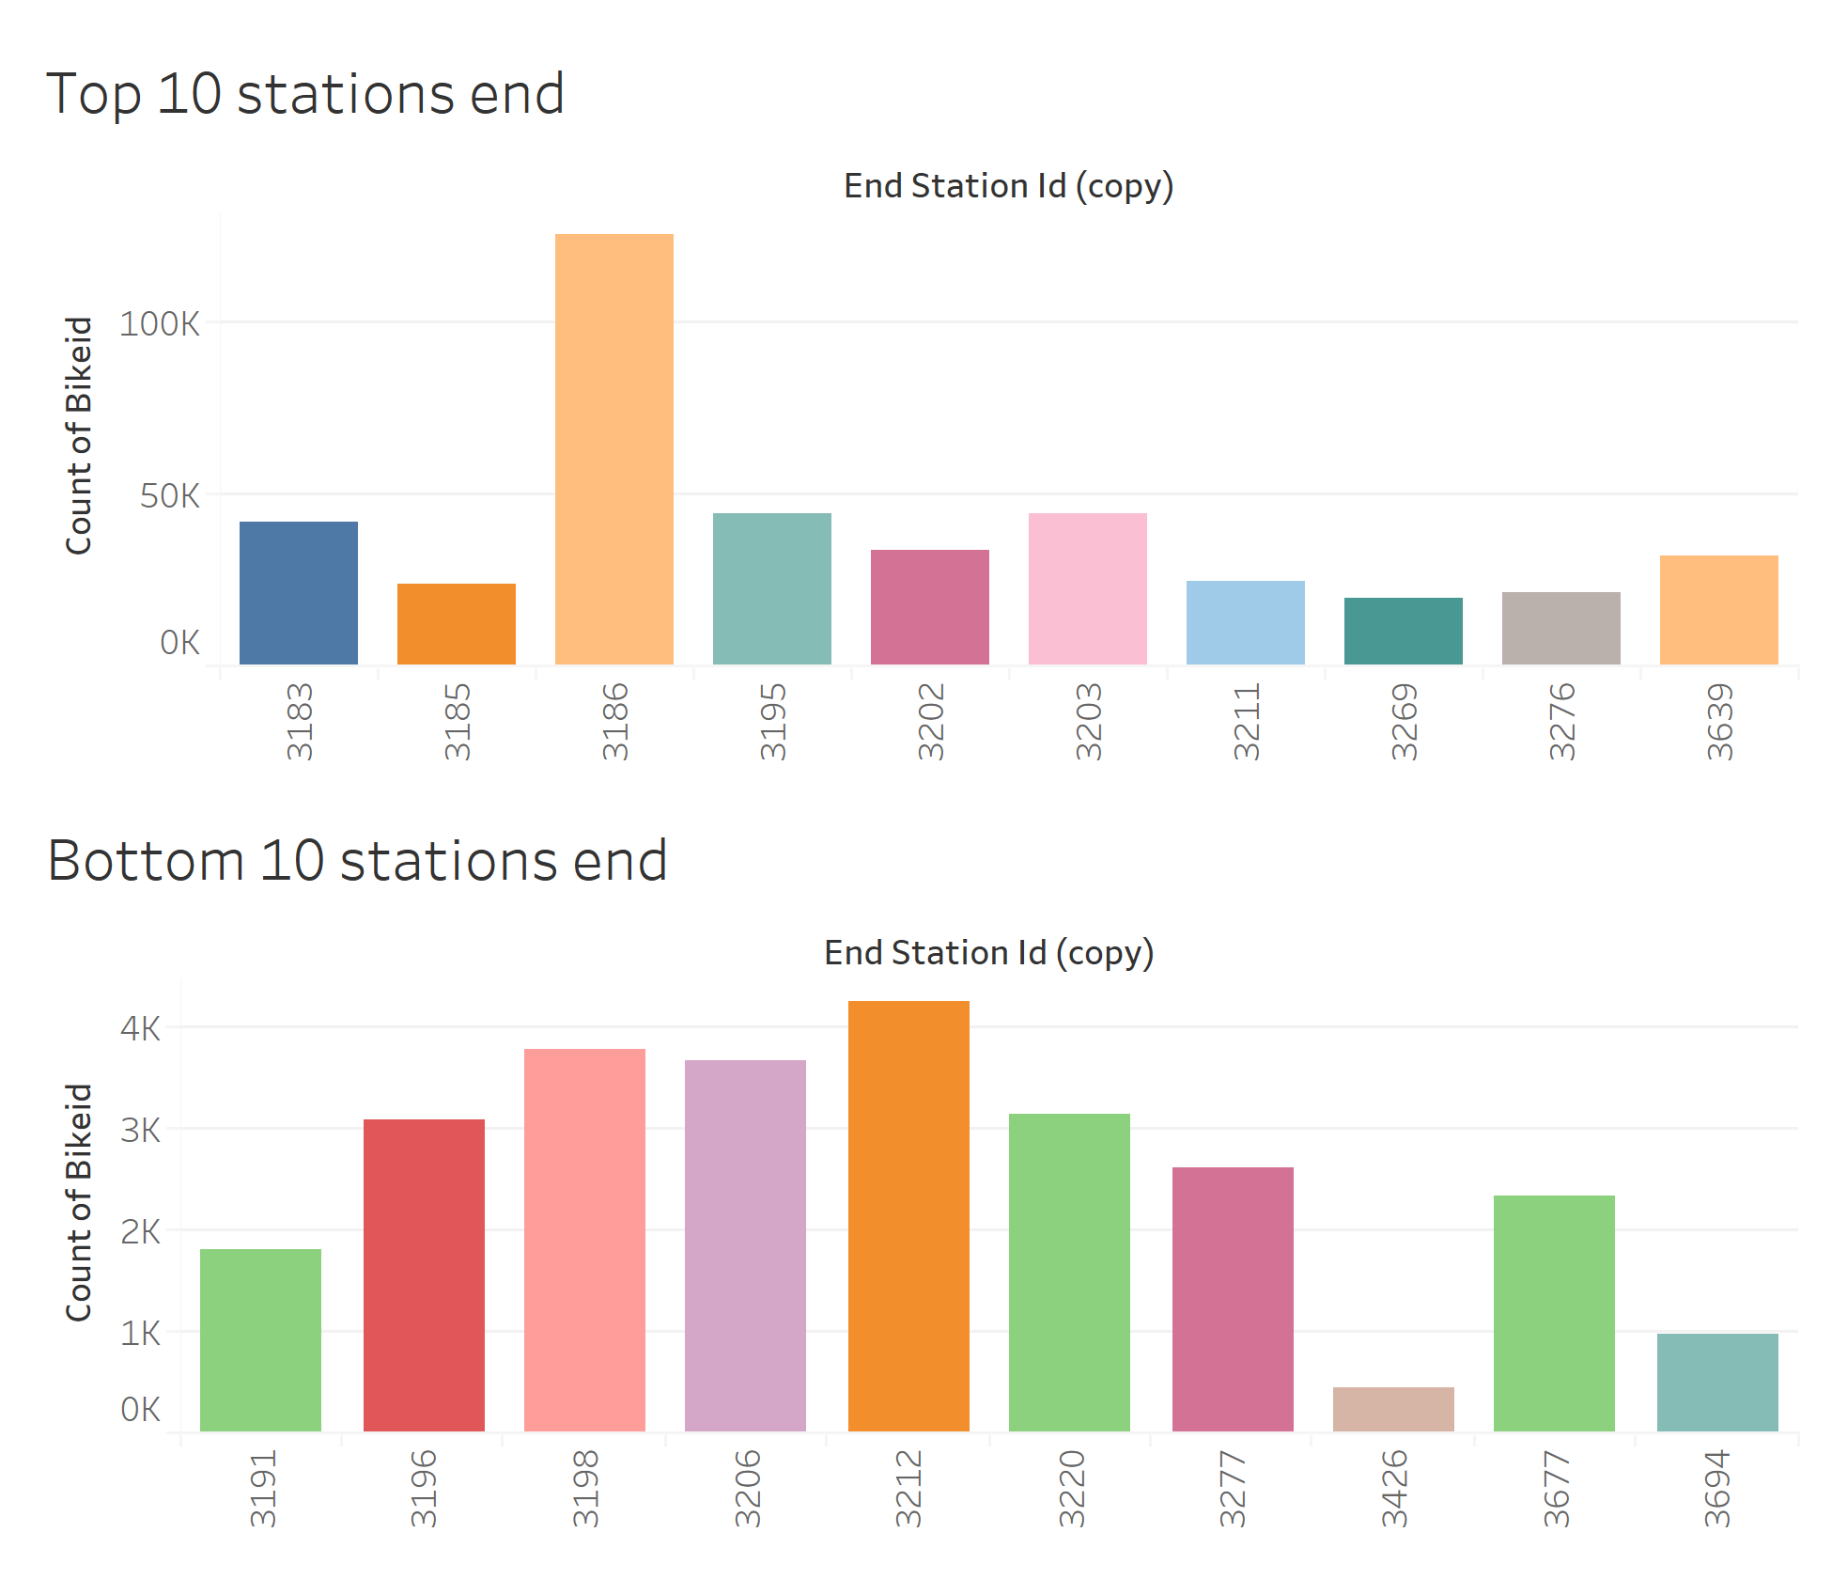
Station 3186 has the highest record for stating/end station.
Station 3426 has the lowest record for starting/end station

Slide 5
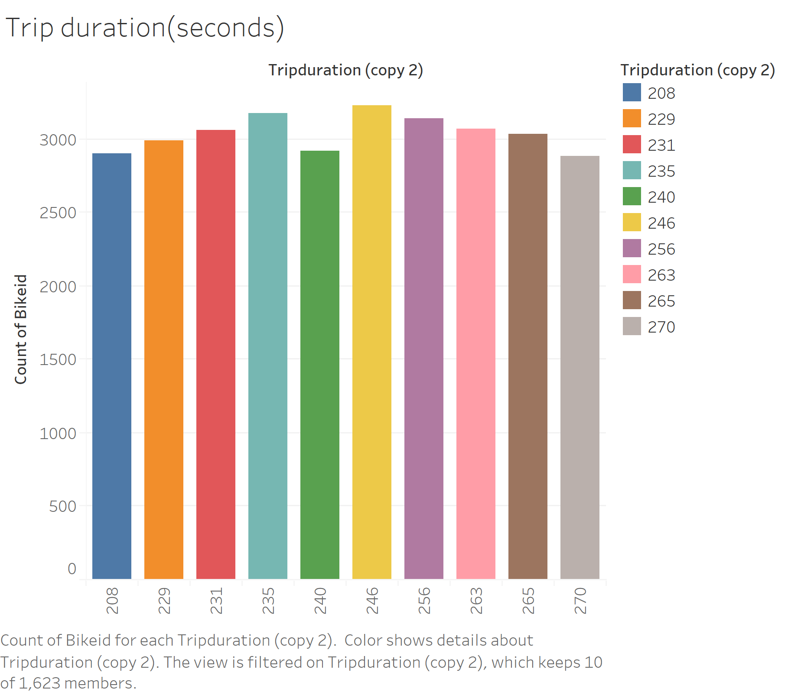
More than 3000 trips were taken within 4 minuites.

Slide 6
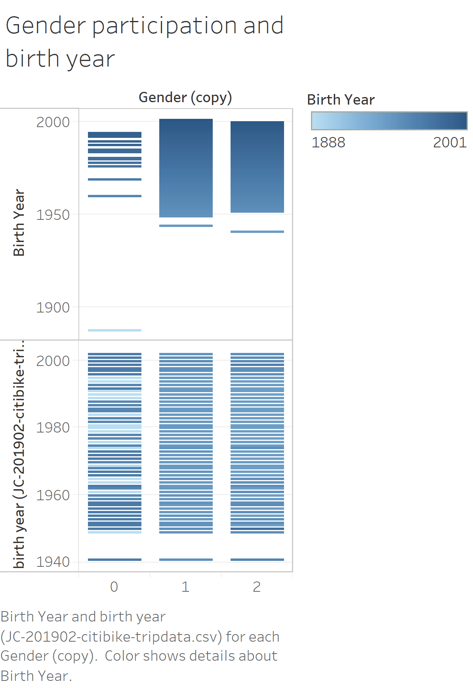
Most of those who ride bikes were born in the late 90’s

Slide 7
Thank you
jjjj

